Slide 1
Product Recommendation Engine for Paychex
Final Presentation
Group 3

Slide 2
Group member
Person Name
Person Name
Second-year MS
Data Science student
Project Manager
Algorithm Engineer
Second-year MS
Data Science student
Person Name
Software
Development
Engineer
Product Engineer
Person Name
Second-year MS
Data Science student
Second-year MS
Data Science student

Slide 3
Introduction
Data Overview
Modeling
Future Work

Slide 4
01
Introduction

Slide 5

Vision & Goals
Vision
Goals
Provide automated and customized services for Paychex’s clients.
Provide executable Python code.
Discover best performance metrics.
Generate well-organized supporting documentations.

Slide 6




Challenges
Binary score
Cold Start problem
Sparse records
Duplicate purchasing histories
Computation difficulty

Slide 7
02
Data Overview

Slide 8
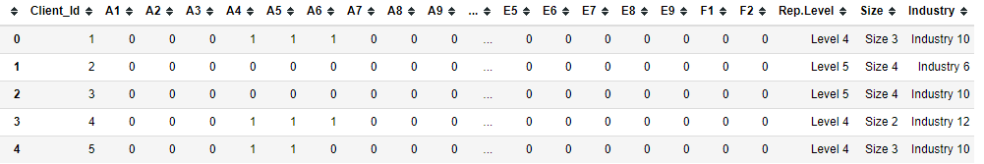
Data Description
Dataset Description
Client ID
Low level Products (40 columns)
1 - Has the product
0 – Dose not have the product
Categorical info about clients.
Client information & purchase history data
382,525 rows with 44 columns
50 MB
Column Name | Description | Note
Client_Id | Client ID | Unique key for each client
A1, A2, …, F2 | Low level product | 0 = ‘has the product’; 1 =‘does not have the product’
Industry | Industry filed of client company | 13 industries, unordered (Industry 1-13)
Rep.Level | Paychex representative level to serve client company | 6 levels, unordered (Level 1-5, Unknown)
Size | Size of Client company (number of employees) | 5 sizes, ordered (Size 1 < Size 2 < Size 3 < Size 4 < Size 5)

Slide 9



Data Cleaning
Wrong value
Duplicate value
Missing value
1 error in low-level product (E2 & F2 = 2)
No duplicate Client Id
No missing value
Notes:
Next is the data cleaning section.
Overall, the data set is very clean
+ With only one row of wrong data
+ And there is no duplicate client
+ And no missing value

Slide 10
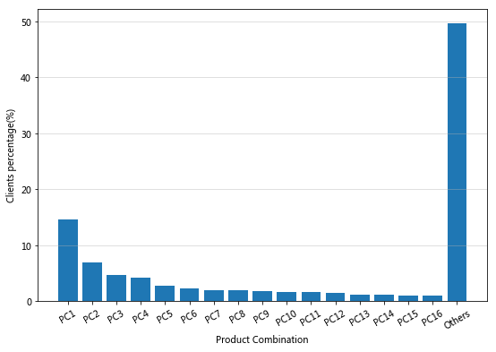
Exploratory Data Analysis
Clients-Product Combination Filtering Funnel
# clients: 382,525
# existing clients: 277,062
# unique PC: 13,257
Distribution of Product combination (PC) in old clients
Existing client: client with purchasing history
New client: client with no purchasing history
Top 16 PCs (all over 1%) takes over 50%
Top 1 PC accounts for 14.57% (40380 clients)
Notes:
Finally, we found there are many clients have the same product combination.
+ The left pic shows the clients -product combination filtering funnel
+ Among all the 383 thousand clients, there are only 277 thousand are old clients,
+ and there are only 13,257 product purchase combinations ( which indicates many clients have the same product combination, about 20.90 each)
+ However, the distribution is very uneven. The right pic shows the distribution of product combinations in old clients.
+ Surprisingly, Only Top 16 product combinations contribute over 50% clients, where the Top 1 PC accounts for about 15% (over 40 thousand users' choice!)
+ This will be discussed in more detail in the following model section.

Slide 11
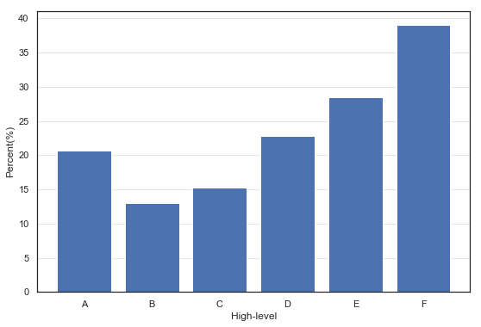
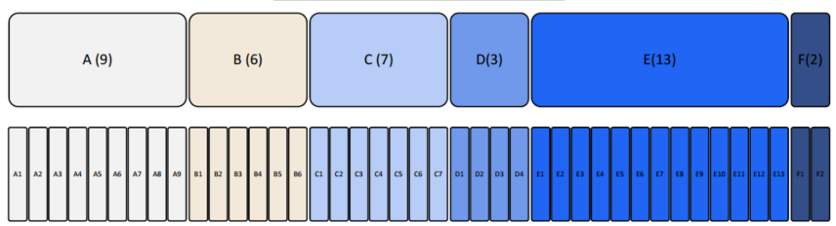
Feature Engineering
High-level product purchasing rate
High-level
product groups
Low-level
product
Product F has the highest purchase rate (about 40%)
Product B has the lowest rate (less than 15%)
Notes:
28% clients are new
Only 13,257 product purchase combinations (average 20.90 clients per combination)

Slide 12
Data Splitting
Original
Cluster 1
Training
Validate
Test
Cluster 2
Training
Validate
Test
Cluster 3
Training
Validate
Test
Cluster 4
Training
Validate
Test
Note:
Training: Validate: Test = 6:2:2

Slide 13
03
Modeling

Slide 14
Model Development Procedure
Step1
User-based Collaborative Filtering
Step2
Step3
Step4
Clustering
Find like-minded users and make recommendation
Low-value Injection
Make use of clients’ information
Singular Value Decomposition
Data imputation
Enhance the performance of SVD
Notes:
Here is the process of building our models. First step is to build a baseline model, user-based collaborative filtering.
Then, we built SVD to do the data imputation, which is used to fill 0s in the matrix.
We find that the approximation to 0s is not reasonable, so we developed low-value injection method.
And finally, we used clustering to do the precise modeling on different groups of users.
I will introduce the baseline model and my teammates will talk about the other three combined methods.

Slide 15
3.1
Model Evaluation Method
Notes:
Before starting to talk about our models, let me first introduce how we calculate the accuracy of our models.

Slide 16


Model Evaluation Method
Decode Process
Original Test Data
User who bought item 1 and item2
User
item1
item2
unbought items
 | Item 1 | Item 2 | …
User | 1 | 1 | 0
Test Branch 1
Test Branch 2
User who bought item 1
User who bought item 2
User
item1
unbought items
user
item2
unbought items
 | Item 1 | Item 2 | …
User | 1 | 0 | 0
 | Item 1 | Item 2 | …
User | 0 | 1 | 0
Notes:
Here is an example of one line of the data. This is a person who only bought item 1 and item 2.
We first divide it into two test branches. it will remove one 1 in the original data, so it generate one person who only bought item 1 and one person who only bought item 2.
Then, we will send it to our algorithm

Slide 17

Algorithm
Validate Process
Test Branch 1
Test Branch 2
User who bought item 1
User who bought item 2
…
…
Predictions(0~1)
of unbought items
Predictions(0~1)
of unbought items
User
item1
User
item2
 | Item 1 | Item 2 | …
User | 1 | Pred_2 | Pred_i
 | Item 1 | Item 2 | …
User | Pred_1 | 1 | Pred_i
If the highest
prediction is
If the highest
prediction is
Item 2
Not Item 2
Item 1
Not Item 1
Correct
Incorrect
Correct
Incorrect
$$Recall@1= \frac{True Positive}{True Positive+False Negative}$$
Notes:
Our algorithm will give us predictions of our test branches, which are numbers between 0 and 1
If the highest prediction is the item we erased, then we consider it is correct. Otherwise it is wrong. The whole process of calculating accuracy is called Recall at 1.

Slide 18
3.2
Baseline Model
Notes:
Here is our baseline model

Slide 19

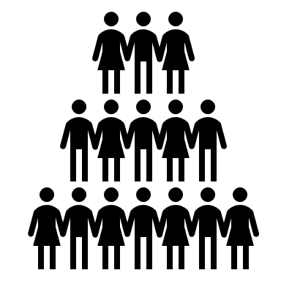



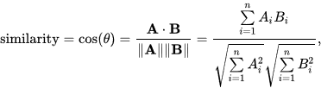
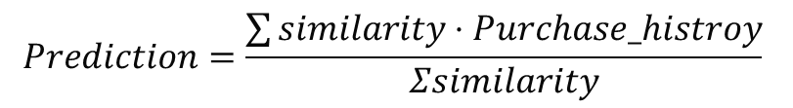
M1: User-Based Collaborative Filtering
Target User
All Users
K Similar Users
Purchase History
Recommendation
$$Prediction=\frac{\sum{similarity}⋅Purchase_histroy}{Σsimilarity}$$
Notes:
Which is User-based Collaborative filtering. User-Based Collaborative filtering algorithm takes the target user information and compare it with all other users purchase history, then it will select k most similar users (k is a number defined by programmer) based on a similarity measurement method here. And then use the similar users’ purchase history to give a recommendation by using the formula here. We also tested item-based collaborative filtering, but the recall@1 for item-based is lower than user-based, so we decided to use–based as our baseline model.

Slide 20
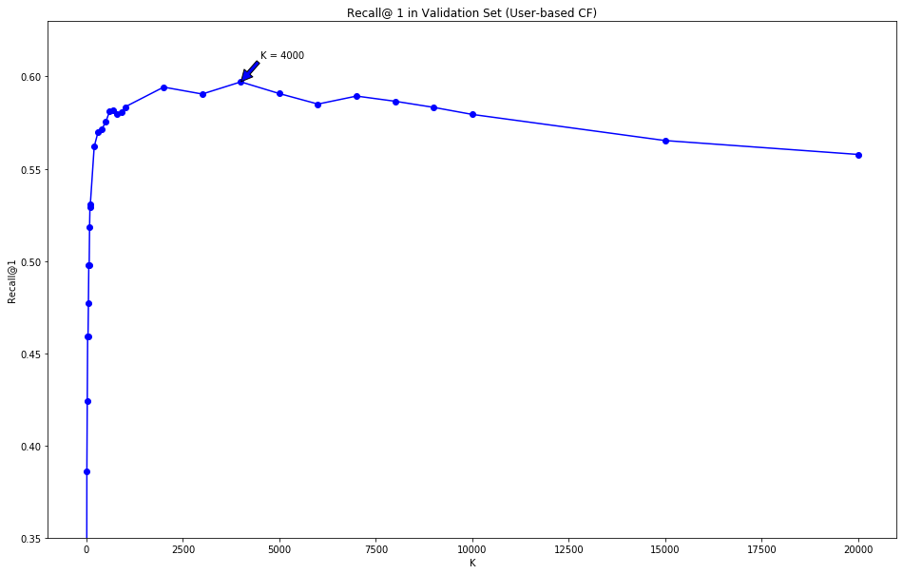
M1: Results of User-based CF
The highest Recall@1: 59.6%
K for the highest Recall@1: 4000
* Note that all Recall@1 here is calculated for low-level products,
Notes:
Here is the results of user-based CF. we can see It has a trend that first goes up and then goes down. Which means that: the algorithm will be more accurate when more similar users is selected within a threshold. The threshold here is 4000. but after passing that threshold, the recall@1 will decrease because the similar users that are being added are not the most similar users of the target user. So k is an important hyperparameter in the testing of algorithms we developed later.

Slide 21
M1: Extensible Coding Structure
Collaborative Filtering (Class)
Similarity (Class)
STEP 1
Train/test Data
Input
STEP 2
Similarity Matrix
STEP 3
Prediction
Performance Metric (Class)
Accuracy value(s) of specific
accuracy measurement method(s)
Notes:
Here is our code structure. We won’t get deep into here. Just want to show this kind of module structure can allow us to maintain and extend our code easily.

Slide 22
M1: Speed & Memory Usage Improvement
Testing one line of data is easy, but testing thousands of data is time-consuming
Stage 1: Linear
Stage 2: Parallel
Stage 3: Partial Parallel
1GB = 1024MB
1MB = 1024KB
Decoded test data
tested one
line at a
time
Decoded test data
Decoded test data
test n = 100
(user-defined
number) lines
at a time
* Time and memory usage here are estimated values
based on the real performance
tested whole
test data
Time Required: >10 h
Time Required: 3~4 h
Time Required: ~16min
Memory Usage: 500MB
Memory Usage: >32GB
Memory Usage: 3GB
Notes:
We have faced the speed and memory usage challenge during the testing of the baseline model. Because testing one line of data only needs 2-3 seconds but there are thousands lines of data. So we first try to parallel the matrix computation by using Python module Numpy. But the program is still time-consuming because the memory usage is high, the program will jump back and forth between ram and virtual memory. Hence, we developed partial parallel method to test our data, which test n lines of data at a time. This partial parallel method decrease the usage of memory, so it will not use the virtual memory of computers, and hence decrease the time.
That’s all we did for our baseline model. The tuning experience of k, the extensible code structure in the previous slides, the fast speed and small memory usage here laid a solid foundation for our algorithms. And now it’s the time to see how we expand our algorithm. Let’s welcome Zhuang.

Slide 23
3.3
SVD
Notes:
Here is our baseline model

Slide 24
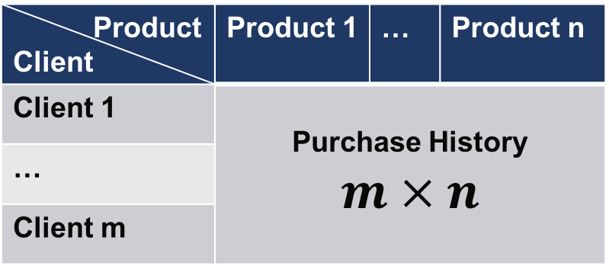
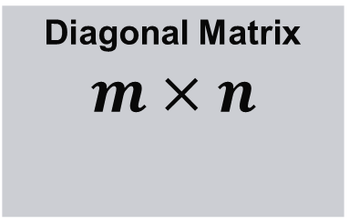
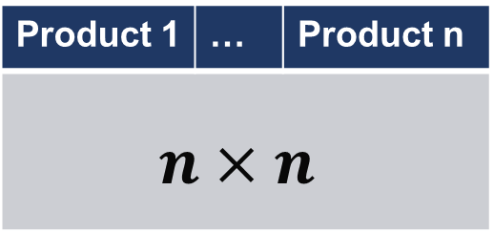
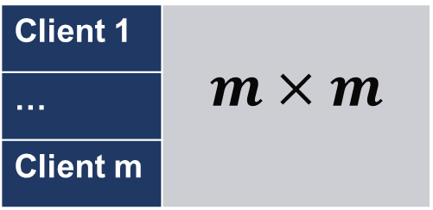
M2: Singular Value Decomposition
Product Client | Product 1 | … | Product n
Client 1 | Purchase History $$m×n$$
…
Client m
Client 1 | $$m×m$$
…
Client m
Diagonal Matrix $$m×n$$
Product 1 | … | Product n
$$n×n$$
Notes:
Singular value decomposition is a factorization of matrix. The algorithm can generate 3 metrics. As you can see, each row in left-singular matrix represent a client and each column in right-singular matrix represent a product. The second matrix is a diagonal matrix, each element is a singular value. The product of these 3 metrics equals to the original matrix.
We can choose how many singular value and singular vector we want to use to reconstruct the matrix. SVD can remove the noise in original matrix and give an estimation to each blank in original matrix.

Slide 25
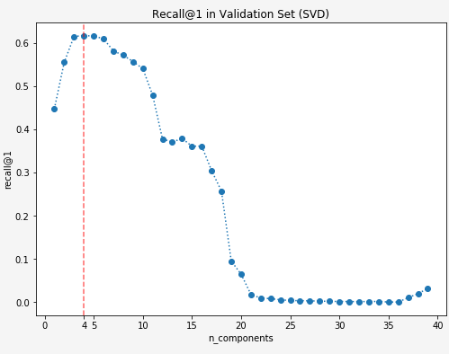
M2: SVD as model
n | 3 | 4 | 5 | 6
Recall @1 | 61.5% | 61.7% | 61.6% | 61.0%
Notes:
It can be used in two different ways. We first built a model use only SVD. Just like PCA, we first learn the hidden pattern from training dataset, and then use the model to transform the testing dataset. We also used decoded testing dataset and recall@1 to evaluate this model. When we use 3 to 6 singular value and vector, the recall@1 of the model are higher than 60%. In these cases, SVD model is better than our UB model.

Slide 26
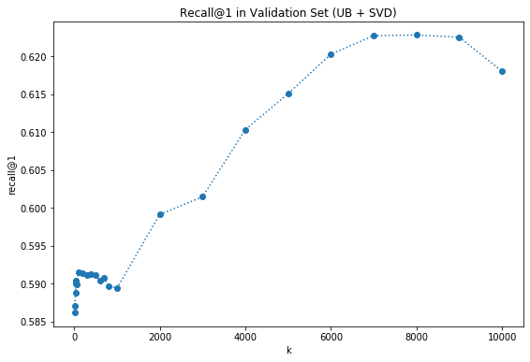
M2: SVD for data imputation
n | 3 | 4 | 5 | 6
Recall @1 | 61.7% | 62.2% | 62.3% | 61.8%
Notes:
Another application of SVD is data imputation. We can apply SVD to reconstruct the whole dataset and then use the new dataset as UB model’s input. As we can see from the graph, this new model shows a better performance than UB model and SVD model. And the best k now changed. Unlike SVD model, in this model, we should use ? singular vector to get the best performance.

Slide 27
3.4
Low Value Injection
Notes:
But there is a drawback.
For data imputation, SVD tries to fit each element in the matrix. But zeros are missing values. Fitting zeros is not meaningful. Hence, we read some papers to fix this problem. We found an algorithm named low value injection. Let’s see how this algorithm works.

Slide 28

M3: Low Value Injection
Probability of buying
new items
User
Unbought products
Low
User who bought lots of products
High
User who bought a few products
User i | 1 | … | 0
User i | 1 | … | Lambda / #bought
Notes:
The users who has bought lots of products are more likely to know unbought products. They may have bought everything they need. But the user who bought a few products may be a new client. We can assume that there are still some products they need. Hence, we want to give an estimation to the probability of a user buying a new product.
According to low value injection, we first replace 0 with a small number. The value of this number is lambda divided by the number of produce this user has bought. We can use different lambda. And then we apply SVD to this dataset. Last, use the reconstructed matrix as ub model’s input.

Slide 29
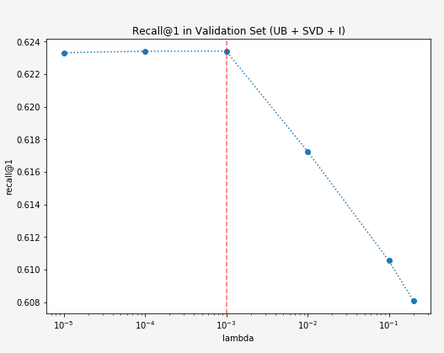
M3: Low Value Injection
According to the result, we choose to use lambda = 0.001
Notes:
According to the result on validate dataset, we think 0.001 is the best value for lambda.
SVD and low-value injection are used for data imputation in our model. We haven’t made use of clients’ information such as the size of their company yet. Sheng will show what we can learn from this information.

Slide 30
3.5
Graph for Clustering
Notes:
Thanks Zhuang!
Let’s see the last model

Slide 31
M4: Graph of Clustering
Using clients info
The past models just focus on purchasing history
Clustering using categorical information of clients
Client ID
Low-Level product purchasing history
Categorical info of clients
Notes:
In the last 3 models, we just focus on the purchasing history data but ignore the categorial information of clients.
We believe the user info will provide us extra clues that will help improve our recommendation performance.

Slide 32
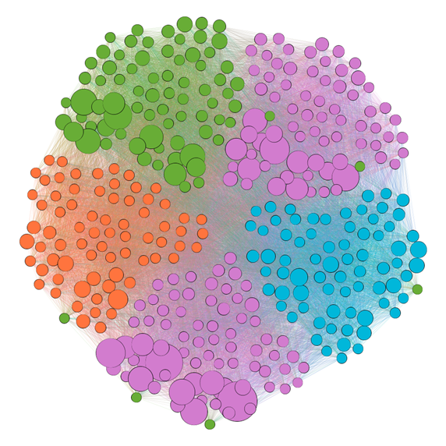

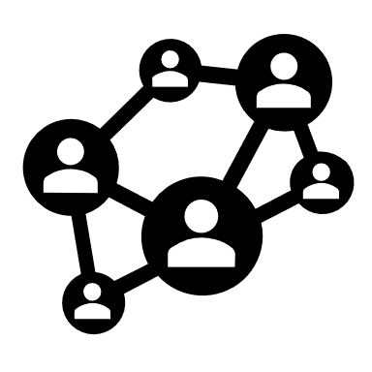
M4: Graph of Clustering
Client_Id | Rep Level | Size | Industry
1
…… | …… | …… | ……
382525
Data
Newman Fast Algorithm
Component
User
Clustering based on Modularity
Graph
Node
Edge
Nodes are connected if they have same info
Clustering results of weighted graph
Weighted graph
Notes:
Here we borrow the idea of graph theory.
Users with all three categorical information are abstracted as nodes and they are connected by nodes if they share same info. The weight of the edge is the reciprocal of the amount of the same user info between nodes.
Newman fast algorithm was implemented to cluster the nodes into 4 clusters, and it is based on modularity.

Slide 33
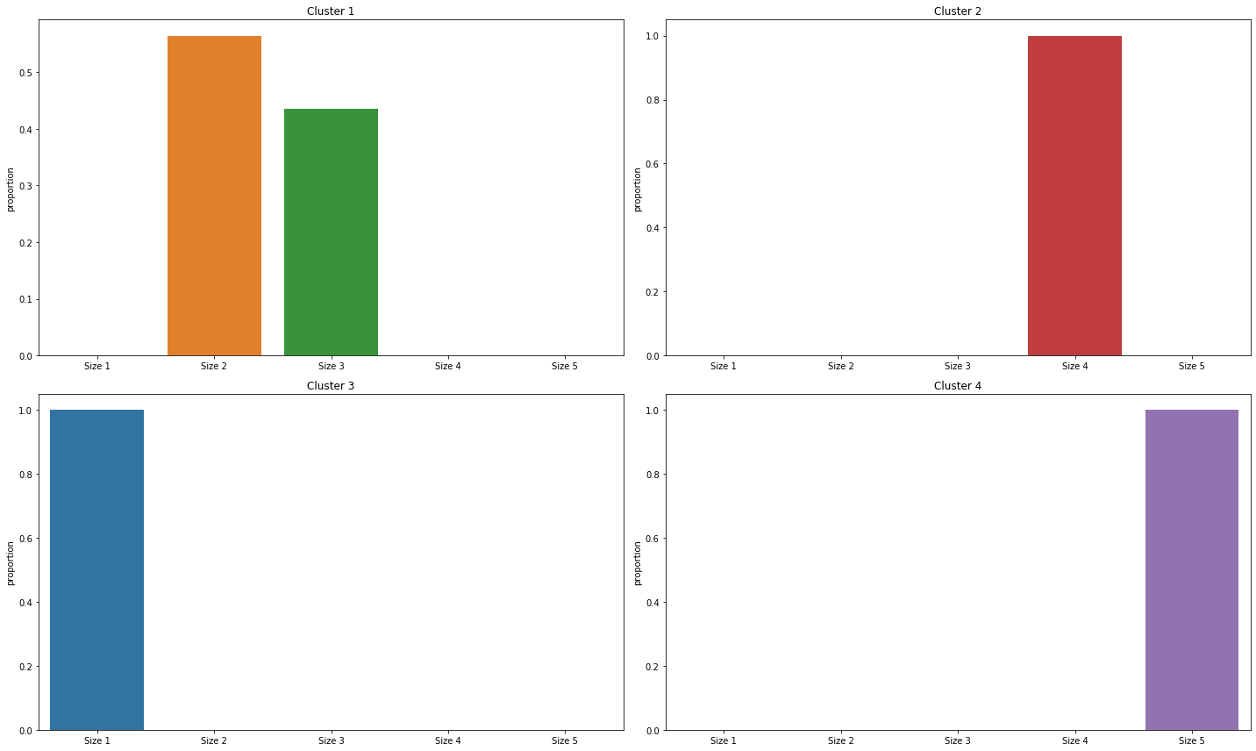
M4: Graph of Clustering
Cluster Name | Cluster 1 | Cluster 2 | Cluster 3 | Cluster 4
# of Clients | 202326 | 103663 | 27483 | 49057
Size | Size 2 & size 3 | Size 4 | Size 1 | Size 5
Divided by size
Clustering results of weighted graph
Clusters vs clients’ size
Notes:
specially, we find the clusters are mainly divided according to the size. For example, cluster 1 consists of size 2 and size 3 clients. While the cluster 2, 3 and 4 are size 4, size 1 and size 5.

Slide 34
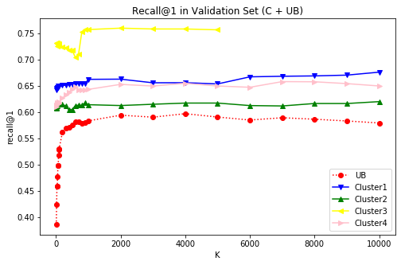
M4: Graph of Clustering
UB+SVD+I+C vs UB
All clustering results are better UB
We can choose the best k for each cluster
Notes:
The recall@1 of our final model (including UB, SVD, I, and C) and UB model is shown in this figure. Obviously , although different clusters has different recall value, all of them are higher than the baseline model. And we can choose the best k for each cluster.

Slide 35
3.6
Model comparison
Notes:
Here is our baseline model

Slide 36
Comparison of different Models
Models with test results
Models | Recall @ 1 on test
M1: UB | 59.71%
M2: UB+SVD | 62.28%
M3: UB+SVD+I | 62.34%
M4: UB+SVD+I+C | 65.31%
Notes:
We find the best parameters on validate dataset, and using different random states to calculate the recall@1 on test dataset. Obviously, each model is better than the previous one.

Slide 37
3.7
Final Results
Notes:
Here is our baseline model

Slide 38
Final Results
Find max score in each High-level
A1 | A2 | A3 | A4 | A5 | A6 | A7 | A8 | A9
0.65 | 0.85 | 0.91 | 0.37 | 0.12 | 0.24 | 0.44 | 0.64 | 0.77
A1 | … | A9 | B1 | ... | C1 | … | D1 | … | E1 | … | F1 | F2
0.65 |  | 0.77 | 0.20 |  | 0.33 |  | 0.78 |  | 0.92 |  | 0.42 | 0.57
Low-level score
High-level score
A | B | C | D | E | F
0.91
Notes:
Since the final output should be a recommendation rank in high-level product for each client.
We choose the max score in each high-level first, and then eliminate final products they already had. Finally, we will rank the high-level products based on their highest score.

Slide 39
Final Results
Find max score in each High-level
B1 | B2 | B3 | B4 | B5 | B6
0.20 | 0.85 | 0.49 | 0.11 | 0.30 | 0.41
A1 | … | A9 | B1 | ... | C1 | … | D1 | … | E1 | … | F1 | F2
0.65 |  | 0.77 | 0.20 |  | 0.33 |  | 0.78 |  | 0.92 |  | 0.42 | 0.57
Low-level score
High-level score
A | B | C | D | E | F
0.91
0.85
Notes:
Since the final output should be a recommendation rank in high-level product for each client.
We choose the max score in each high-level first, and then eliminate final products they already had. Finally, we will rank the high-level products based on their highest score.

Slide 40
Final Results
Rank High-level Products
Already bought
A | B | C | D | E | F
0.91 | 0.85 | 0.44 | 0.88 | 1 | 0.57
Client_id | NO1 | NO2 | NO3 | NO4 | NO5
1 | A | D | B | F | C
Notes:
Since the final output should be a recommendation rank in high-level product for each client.
We choose the max score in each high-level first, and then eliminate final products they already had. Finally, we will rank the high-level products based on their highest score.

Slide 41
04
Future Work

Slide 42
04 Future work
Potential Improvement:
Duplicate records handling
Extend our model evaluation metric for ranking (e.g., recall@k)
Wrap up our code
Finish paperwork

Slide 43
Acknowledgement
Thanks for
Paychex Data Science Team
Professor Anand
Professor Fernandez!
Notes:
Finally, we want to thank our sponsor, Paychex Data science team, who offered us the dataset and gave us a lot support and suggestions on the recommendation system design.
We also want to thank Professor Anand, and Professor Fernandez. They also gave us some very valuable ideas and showed us skills on presentation.

Slide 44
Q&A
Group 3

Slide 45
Thank you for listening!
Group 3

